Slide 1
DEMOGRAPHIC PROFILING
Under guidance of:
Dr. Imran Khan
Assistant Professor
Submitted by:
Vineet Vijayan
04011604416

Slide 2
CONTENTS:
Company profile
Objective
Technologies used
Data Collection and Extraction
Use case diagram
Data flow diagrams
Sequence and Activity Diagrams
Selection of Features
Procedure of Analysis
Screenshots
Results
Conclusion
Limitations
Future prospects
References

Slide 3
COMPANY PROFILE:
Company name: Aam Aadmi Party
Aam Aadmi Party (AAP), is an Indian political party, formally launched on 26 November 2012, and is currently the ruling party of the National Capital Territory of Delhi.
It deals in various profiles like HR, Public Speaking and Data Analytics.

Slide 4
OBJECTIVE:
Percentage variation in gender ratio, young female voters and their correlation with the affluence of an area.
Variation in affluence within one constituency.
We noted variations between smallest possible population groups. i.e. at block level.
We saw a dramatic increase in female voter turnout in 2014 Parliamentary election.
We explored the significance of female votes.

Slide 5
TECHNOLOGIES USED:
Python 3.7 with various libraries
Libraries:
Numpy
Matplotlib and Seaborn
sklearn
Pdf2Image, Optical Character Recognition (OCR), Python Imaging Library (PIL), OpenCV and Tesseract
Jupyter Notebook
Anaconda
Microsoft Excel

Slide 6
DATA COLLECTION:
We extracted electoral roll using image processing. Source of this data is election commission’s website.
Collection of features was done through web scraping.
Optical character recognition techniques were used in image processing and geolocation API was used in web scraping.

Slide 7

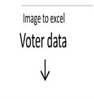
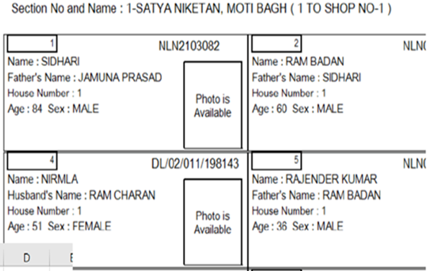
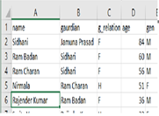

Slide 8
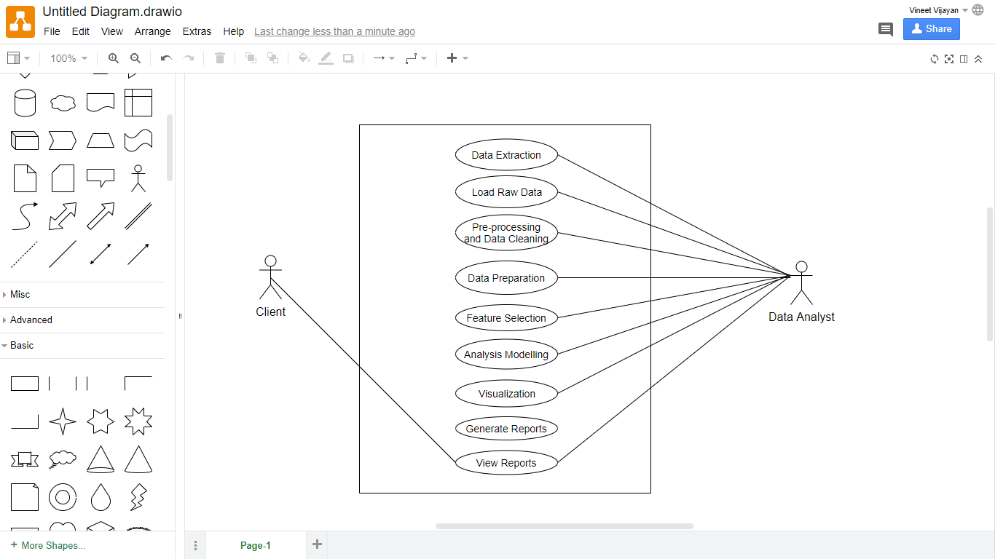
USE CASE DIAGRAM:

Slide 9
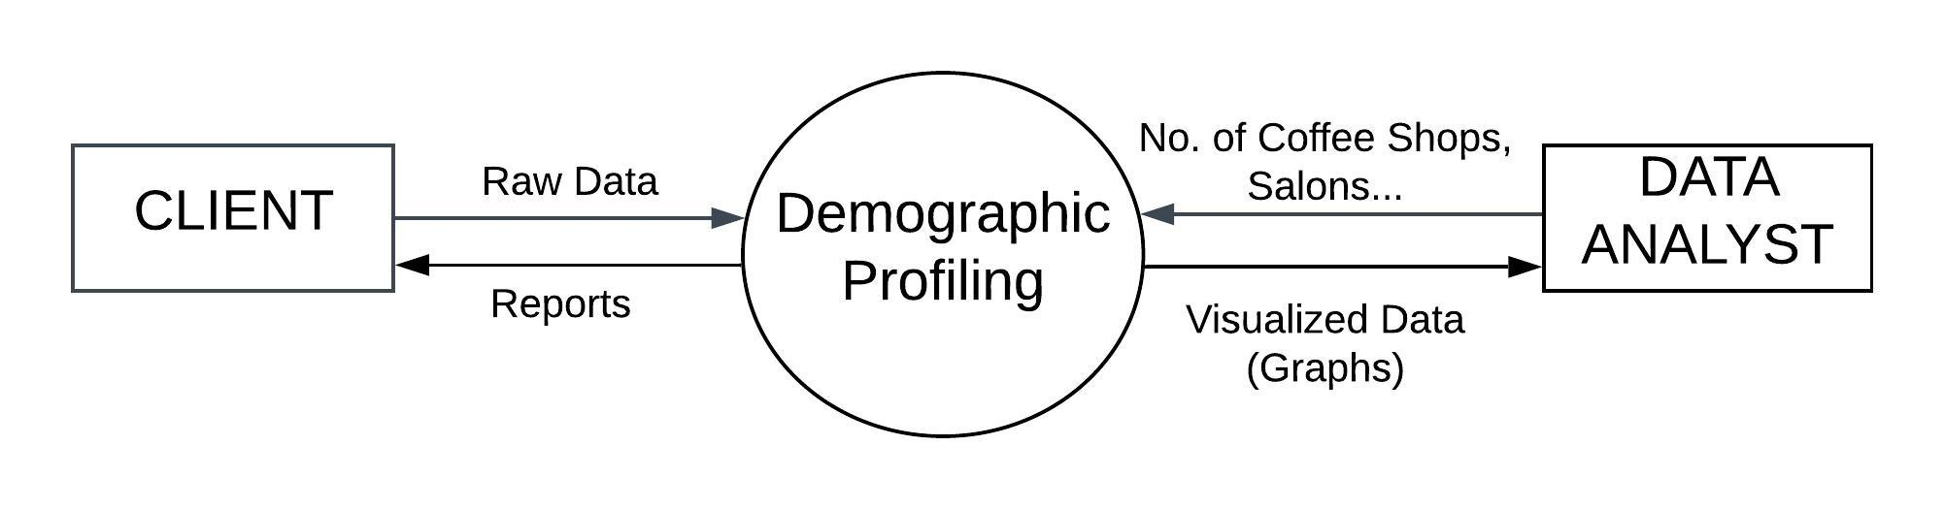
DFD: Level 0

Slide 10
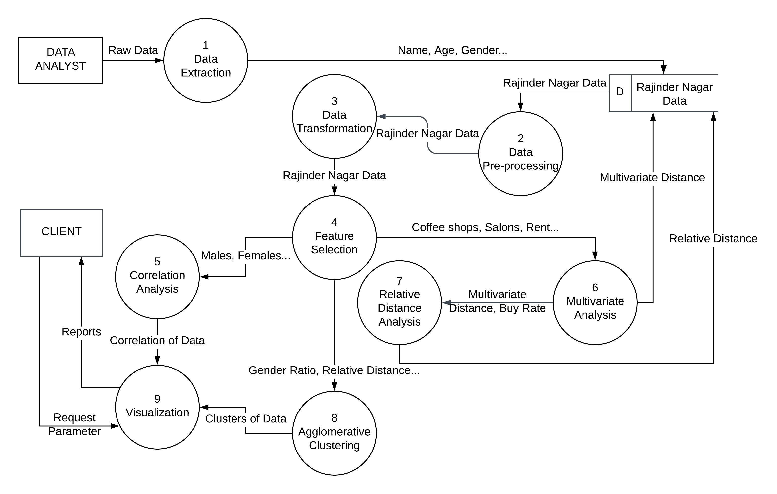
DFD: Level 1

Slide 11
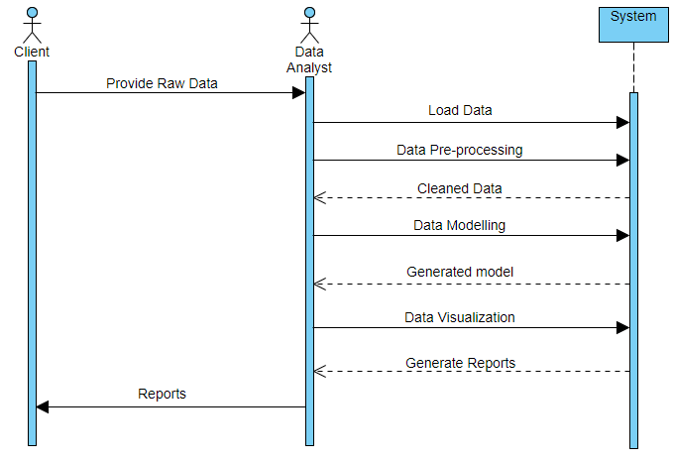
SEQUENCE DIAGRAM:

Slide 12
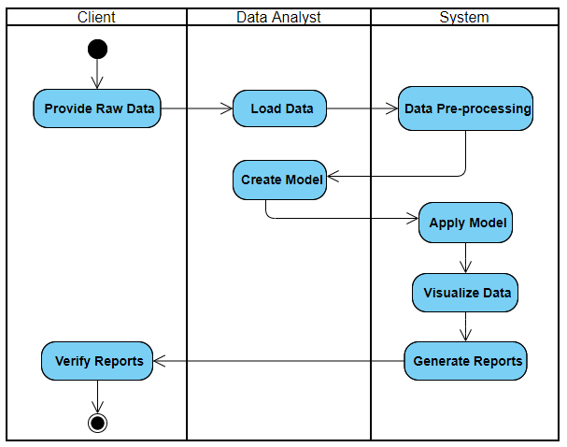
ACTIVITY DIAGRAM:

Slide 13
SELECTION OF FEATURES:
Features were selected such that their combination could give us a good measure of affluence.
Those coffee shops and salons were selected which would be visited by people from affluent areas.
We set a benchmark in terms of cost and distance from a locality. Distance was set keeping in mind the geo-locations of coffee-shops and salons.
For example: Most coffee shops are found near a market place and a market is visited by people living within 1 km area distance.
Cost was selected such that it can give a good approximation about purchasing power.
Property rates were the last piece of the puzzle. As there could be a coffee-shop located which is closer to both an affluent area and an area with high population density.

Slide 14
PROCEDURE OF ANALYSIS:
Through electoral roll data, we calculated gender ratio and young female likelihood.
We first found the correlation between different features.
We did a Multivariate analysis through which we assigned a value to each Part no. of a constituency.
Then, we found a centroid of all the Part nos. and did our analysis by measuring the relative distance from the centroid.
We analyzed the variations in above calculated values with respect to affluence.
Lastly we performed clustering and visualized our data for analysis.

Slide 15
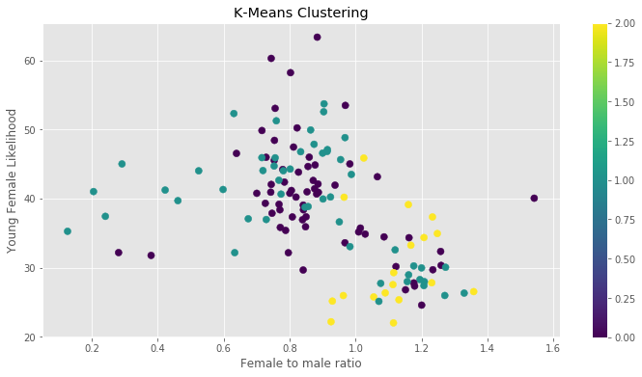
K-means Clustering: Young female likelihood vs Female to male ratio.
Young female likelihood decreases as female to male ratio increases.

Slide 16
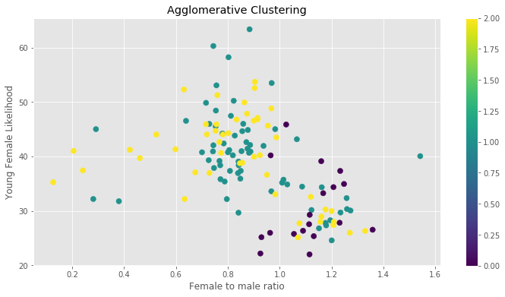
Agglomerative Clustering: Young female likelihood vs Female to male ratio.

Slide 17
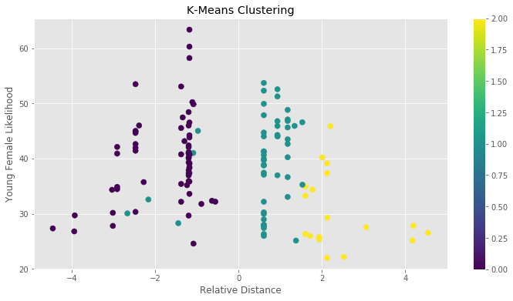
K-means Clustering: Young female likelihood vs Relative Distance.
There are more number of young females near the centroid that means near munirka dda flats.

Slide 18
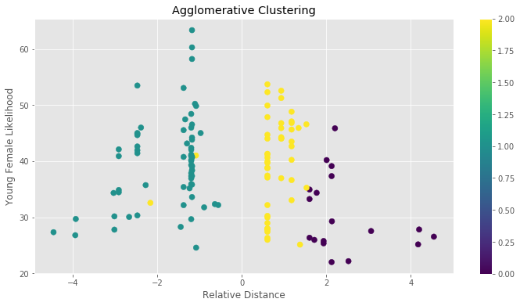
Agglomerative Clustering: Young female likelihood vs Relative Distance.

Slide 19
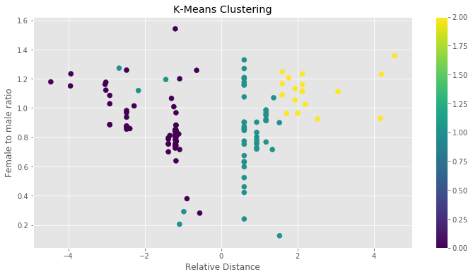
K-means Clustering: Female to male ratio vs Relative Distance.
Females are more near centroid that means females are more near munirka dda flats.

Slide 20
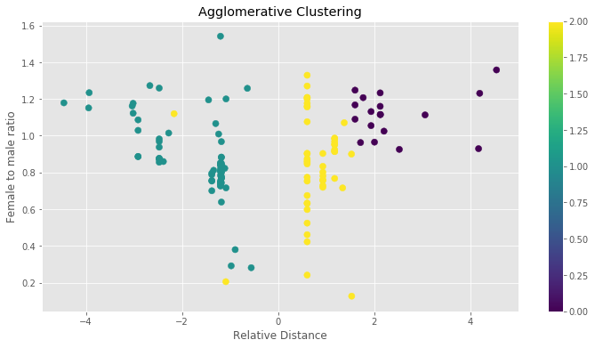
Agglomerative Clustering: Female to male ratio vs Relative Distance.

Slide 21
RESULTS:
Accuracy of Clustering Algorithms is depicted by following confusion matrices below:
K-means Clustering
Agglomerative Clustering (Ward Linkage)
 | Predicted Cluster 0 | Predicted Cluster 1 | Predicted Cluster 2
Actual Cluster 0 | 61 | 4 | 0
Actual Cluster 1 | 3 | 34 | 0
Actual Cluster 2 | 0 | 13 | 18
 | Predicted Cluster 0 | Predicted Cluster 1 | Predicted Cluster 2
Actual Cluster 0 | 0 | 1 | 0
Actual Cluster 1 | 15 | 66 | 48
Actual Cluster 2 | 3 | 0 | 0
Accuracy Score = 0.8496
Accuracy Percentage = 84.96%
Accuracy Score = 0.4962
Accuracy Percentage = 49.62%

Slide 22
CONCLUSIONS:
Thus, it can be seen clearly that K-means clustering algorithm gives better results for this data.
It can be used to study voters base in the constituency and target them accordingly(ward level micro targeting.
Formulate strategies to target the younger audience digitally effectively.
Many localities have slum area near them which can be identified by data and accordingly targeted for building narratives.
Ward wise narrative can be formed according to the data such as % of Female and Male.
Areas with higher no. of married women can be targeted with policies and narratives keeping in view with the family orientation.
We may derive future health, education and family policies keeping in view of our analysis done, so as more voters can be attracted as we can extrapolate central gist of families in an area; bases upon there current female trends.

Slide 23
LIMITATIONS:
The only limitation of this model is that it only works in the current time-space only.
It may vary after 5-10 years or as the space/region changes.
The model may show different results outside Delhi-NCR.
The model may show different results outside Delhi-NCR.

Slide 24
FUTURE PROSPECTS:
We can further extend this project by conducting inter-cluster analysis (between two or more different constituencies, for example: R.K. Puram and Rajinder Nagar).
Currently we have only conducted intra-cluster analysis (within one constituency).
We can predict features of other constituencies by determining the similarity of their regions based on the affluence of that region.

Slide 25
REFERENCES:
Tutorials point: Online education resource
Scrape hero: Online web scraping tutorials
Stack overflow
Christopher M. Bishop, “Pattern Recognition and Machine Learning”, Springer, 2006
Jiawei Han, Micheline Kamber and Jian Pei, “Data Mining Techniques and Concepts”, Morgan Kaufmann Publishers, 3rd Ed., 2012
Allen B. Downey, “Think Stats: Probability and Statistics for Programmers”, Green Tea Press, 2011

Slide 26
THANK YOU

